Slide 1


HHH – THE RIDE APP
a Kings of code software package
Tim Haxton, Cooper wolf (Lead), Jon scales
Iteration 2

Slide 2
Current state of business
No mobile app exist for HHH
Registration done through 3rd party
BikeReg.com
HHH information available via website: www.hh100.org

Slide 3
Goals of our system
Significantly improve efficiency of same day registration for riders.
Provide all guest with information about HHH

Slide 4
Wish List 1
Streamlined data entry for on-site participant registration
Database of participant information linked to BikeReg database and accessible by HHH admin
At-A-Glance HHH weekend event information for app users
Links to local area attractions for app users
Ability for users to view tradeshow vendor lists and goods type
Ability for riders to make SAG request during their event with map location
Route maps with current rider location

Slide 5
Wish list 2
Intuitive interface to allow HHH admin to access participant information in cases of medical or safety emergencies.
Intuitive GUI for registration volunteers to look up riders and assign rider bib numbers

Slide 6
Needs: potential participants
Register on-site
View route maps
View weekend event schedules
View local information (dining, lodging, etc.)

Slide 7
Needs: HHH volunteers / Admin
Database of participants
Database access to assign rider bib number
Database access to look up rider info for medical emergencies

Slide 8
Functional Requirements 1: All USERS
The application shall provide pages for the HHH weekend events schedule & planner
The application shall provide pages for the HHH tradeshow vendor list & map
The application shall provide pages for the HHH routes map & tracker
The application shall provide local information guide links to participants

Slide 9
Functional Requirements 2: participants
The application shall allow participants to register for any event on the day of the event
The application shall allow participants to make a SAG assistance request

Slide 10
functional Requirements 3: HHH volunteers
The application shall provide access to the on-site registration database
The application shall provide for assignment of rider bib numbers by HHH volunteers
The application shall provide SAG request response with rider location info
The application shall request username and password authentication to allow HHH volunteer access on an as-needed basis to database functionality

Slide 11
Functional Requirements 4: justifications
The application shall provide pages for the HHH weekend events schedule & planner
Inform riders of event start times
The application shall provide pages for the HHH tradeshow vendor list & map
Advertise local businesses
The application shall provide pages for the HHH routes map & tracker
Inform users on event routes

Slide 12
functional Requirements 5: justifications
The application shall provide local information guide links to participants
Provide information for those out of state/country
The application shall allow participants to register for any available event on the day of the event
On-site registrants need a quick and easy registration process
The application shall allow participants to make a SAG assistance request
Riders need the ability to contact SAG

Slide 13
functional Requirements 6: justifications
The application shall provide access to the on-site registration database
Administrators need the ability to assign bib numbers
The application shall provide for assignment of rider numbers
Each rider requires a unique bib # for identification during the ride

Slide 14
functional Requirements 7: justifications
The application shall provide SAG request response with rider location info
SAG will need to know the location of the rider in need

Slide 15
functional Requirements 8: justifications
The application shall request username and password authentication to allow HHH volunteer access on an as-needed basis to database functionality
The database information collected from all participants should be kept secured
Limiting access to the database to a select number of trained volunteers will limit the potential for unintentional alteration of the database.
HHH volunteers require a level of access to be perform the tasks of rider lookup by name in order to assign rider bib numbers and take payment.

Slide 16
Non-functional Requirements 1
Performance
System shall maintain maximum load time of 3 seconds
System shall handle 1,000 concurrent users
System shall maintain frame rate of at least 60 FPS
Safety
System shall prevent data loss in the event of an app crash.
System shall perform regular database backups.

Slide 17
Non-functional Requirements 2
Security
The application shall provide a level of administrative access to HHH-side volunteers
Quality
System shall be available throughout the HHH weekend
App shall function on iOS, Android, and Windows

Slide 18
Non-functional Requirements 3: Justifications
System shall maintain a maximum load time limit of 3 seconds
Ensure users time isn't wasted from loading screens
System shall handle 1,000 concurrent users
There are a great number of riders that register on-site
System shall maintain frame rate of at least 60 FPS
Ensure smooth UI animations
System shall prevent data loss in the event of an app crash
There needs to be minimal impact in the event this happens

Slide 19
Non-functional Requirements 4: justifications
System shall perform regular database backups
Ensures data can be restored if something were to occur
System shall securely authenticate requests to access database
Ensures only those will the correct credentials will be granted access
System shall be available all throughout HHH weekend
Users need to be able to view the page for any information for the whole weekend
App shall be functional on iOS, Android, and Windows
Ensures majority of phone users will have access to our app

Slide 20
CONSTRAINTS 1: overview
Software restrictions
Resources/tools restricted to free versions
Time limitation - Project deadline : April 26
Agile methodology
Skillsets

Slide 21
CONSTRAINTS 2: Software
Front End Development Language Restrictions
Software language limited to JavaScript, Dart, Python, Django
Back End Development Language Restrictions
Software language limited to C++, Python, Java
Database restricted to an SQL type
Considerations: all languages could be used for this project although some are better suited than others. These language constraints are imposed from outside of the project scope

Slide 22
CONSTRAINTS 3: Software
An API is required to process communication between the front end user interface and backend database.
The interactive nature of an app such as ours will require a restful type API
Considerations: Our team members have limited experience utilizing SQL and API methods/software which may cause suboptimal app performance issues.

Slide 23
CONSTRAINTS 4: freeware
This app will be available for free to HHH users
The resources/tools to develop the app are thusly restricted to freeware versions
Considerations: We really don't need anything that would require payment.

Slide 24
CONSTRAINTS 5: project deadline
Project deadline April 26
One remaining iteration waypoint prior to deadline
Considerations: Time limitation could negatively impact product development

Slide 25
CONSTRAINTS 6: project management
The agile project management system is required to be implemented in the development of this project
Considerations: Agile is a suitable management style for a project of this scope.

Slide 26
CONSTRAINTS 7: skillset
Members of this team are fairly proficient with python and C++ programming
The team has almost no experience with designing mobile apps
The team has limited experience with database and API use.
Considerations: There has been and will continue to be a steep learning curve the team must surmount to complete this project

Slide 27
CONSTRAINTS 7: justifications
Frontend restricted to Javascript (react native), Python, Dart (flutter)
Could be more efficient languages or frameworks
Database restricted to SQL (MySQL)
Could be more optimal database languages
Time limitation - Project deadline : April 26
Restricts time needed for development and testing

Slide 28
Constraints 8: justifications
Resources/tools restricted to free versions
Limitations to features and performance
Agile methodology
Scope creep and misaligned expectations
Skillsets
Lacking expertise in Flutter, FastAPI, and MySQL

Slide 29
Derivation of requirements 1: Techniques Utilized
Interview
Brainstorming
Use Case Analysis

Slide 30
Derivation of requirements 2: Interviews
HHH on-site registration volunteers
Jon Scales (Kings of Code team member)
Patrick Mitchell
Interviews with these volunteers identified needs and desired features of the app for the on-site registration process itself

Slide 31
Derivation of requirements 3: brainstorming
Brainstorming among Kings of Code team members
This activity revealed features necessary to make the app more expansive for HHH participants
Features such as ride maps, event schedules, local dining & lodging information.

Slide 32
Derivation of requirements 4: Use case analysis
Preliminary use-case analysis allowed visualization of app user categories and behavior
Suggests 3 categories of app users
Spectators
Riders
Volunteers
Suggests how each user type will interact with the app

Slide 33

What is the HHH Organization
What
Current situation
How does it operate

Slide 34
System Context
System will serve as an interface for HHH attendees to better experience the event
Better event registration system replacing current cumbersome system
Expanded functionality to provide with additional event & regional information

Slide 35
Existing Business processes
What are they
BikeReg
Active
Input and Output
Rider information
Entry to database and confirmation receipt
Relationships
Domain Competition
Only participant database and registration portal

Slide 36
Current system deficiencies
On-site registration is cumbersome using BikeReg.com site
Solely for registration purposes
No access to local business information – dining, lodging
Only printed or web-access to schedule of events
No tradeshow vender/product list/info

Slide 37
Product goals
Significantly improve efficiency of on-site registration for riders and HHH volunteers
Provide all guest with additional information about HHH and select Wichita Falls businesses

Slide 38
Users current and future systems
Present system
HHH participants register on-site using BikeReg system
HHH volunteers must navigate BikeReg database
Future system
All app users have access to additional features of The Ride App
HHH participants will register on-site via The Ride App
HHH volunteers will use The Ride App to interact with database

Slide 39
User needs & priorities
User needs the ability register for their event in a timely manner
They need the ability to view their course maps and different events that will be going on that weekend

Slide 40
considerations
Quality
Intuitive, easy-to-navigate interface
Handle errors gracefully
Performance
Fast loading times
Smooth UI animations
Security
Authentication tokens to secure API endpoints
Use of HTTPS for all communications

Slide 41
Business domain: Event Management - SPorts & recreation
Athletes
Amateur
Professional
Recreationalists
Casual
Extreme
Spectators
Venders
Clothing
Equipment/Gear
Nutrition/Health
Artwork/Memorabilia

Slide 42
Business domain: info 1
Our software system can be seen as a management tool applicable for the event management business domain for sports and recreation events such as HHH
HHH steering committee member Jon Scales
Supplied information regarding operations occurring at HHH weekend event.
Web searches
Identified similar business domains

Slide 43
Brainstorming 1
Important application domain concepts
Properties/Attributes
Rider
Administrator
Registration
Opening application
Calling SAG
Accessing application services (event calendar, vendor list)
Registering for an event
Rider info (name, age, bib #, etc.)
Accessing/updating/maintaining registration database
usernames/passwords

Slide 44
Brainstorming 2
List relationships
Rider is a user
Administrator is a user
Rider registers for a race.
User signs up in the app
User views event calendar, vendor list, etc.
Nouns / Noun phrases
User
Rider
Volunteer
Administrator
Map
Event
List

Slide 45
Classifications: Classes (Database/Backend)
User – Stores basic info of every app user
First/Last name, Email
Rider – Stores rider data input from registration form
User_ID, Gender, City, State/Country, Phone, Emergency info
Admin – Stores admin username and password
User_ID, Username, Password
Event – Stores event category and bib number associated to particular event and rider.
Rider_ID, Category, Bib_Number

Slide 46
Classifications: Attributes
Class | Attributes | Values
User | Name, email | Ricky Bobby, ricky@races.com
Volunteer (User) | Username, password | Jane Doe, janedoe@email.com, voluntold, secretpassword
Rider (User) | Phone#, address, age, gender, emergency contact, emergency contact phone#, Event, RegForm | (Ricky Bobby, ricky@races.com,) (123)254-1423, 45, M, Mrs.Bobby, (123)234-5678, EnduranceRide, RegEndurance1,
Event | Name, date, Rider, RegForm | EnduranceRide, Saturday, RickyBobby, RegEndurance1
RegForm | Rider, bib#, eventname, waiver | RickyBobby, 7800, endurance, true

Slide 47
Classifications: Inheritance
User is parent class for both Volunteer and Rider child classes
Users will have basic functionality of all information aspects of the application
Users will be able to register for events at which time, the attributes held in the user object will be passed to the constructor for a Rider object
When a user object uses the login function, a Volunteer object will be instantiated.

Slide 48
Classifications: Aggregation
Shared aggregation
Event has a RegForm (1 Event has many RegForms)
Event has a Rider (1 Event has many Riders)
Composite aggregation
_RegEnduranceWidgetState has a _model
_model is disposed when _RegEnduranceWidgetState ends (changes)

Slide 49
Classifications: Multiplicity
1 Rider may register for >= 1 event
1 Rider is associated with >= 1 RegForm
1 Event may have >=0 Rider
1 Event may have >= 0 RegForm
1 Event is associated with 1 RouteMap

Slide 50
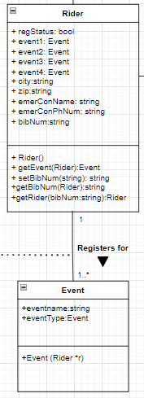
UML diagrams - Association & multiplicity
Rider is associated with an Event
1 rider may register for >=1 events

Slide 51
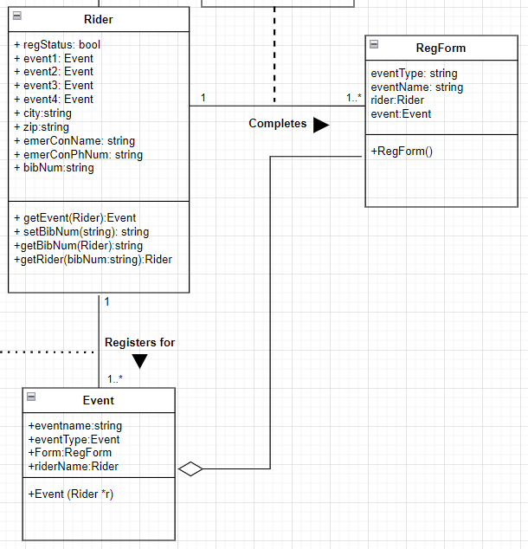
UML diagrams - aggregation
The classes for the backend code demonstrate aggregation.
Event objects will contain RegForm objects

Slide 52
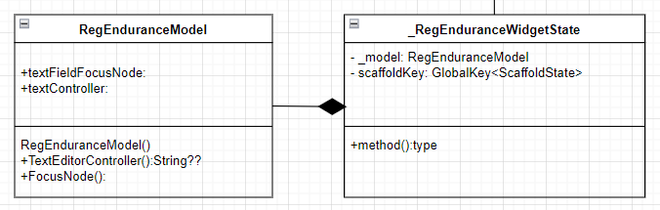
UML diagrams - aggregation
The classes for the frontend dart code demonstrate aggregation.
_RegEnduranceWidgetState (the state of a page in the app) contains an object _model which is an instance of the RegEnduranceModel class
The _model has attributes and methods to handle the text fields of the _RegEnduranceWidgetState object, which is the layout of the RegEndurance Page of the app.

Slide 53
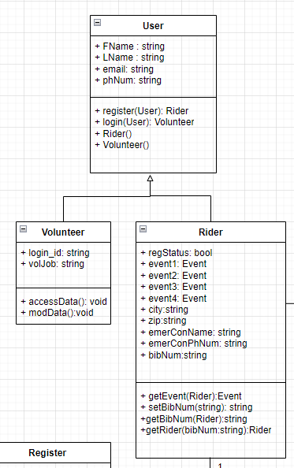
UML diagrams - inheritance
User is a parent class generated when an app user activates their app.
Rider and Volunteer are child classes derived from User.
Volunteer extends User to allow access to database
Rider extends User by using the register class to register for an Event

Slide 54
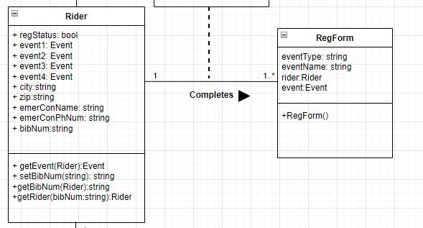
UML diagrams - multiplicity
1 rider will have >= 1 registration form

Slide 55
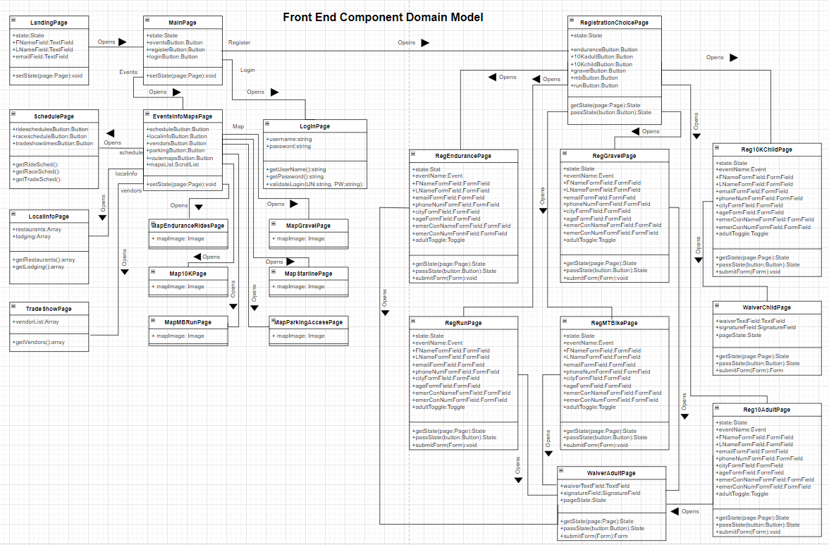
Front End app page associations

Slide 56
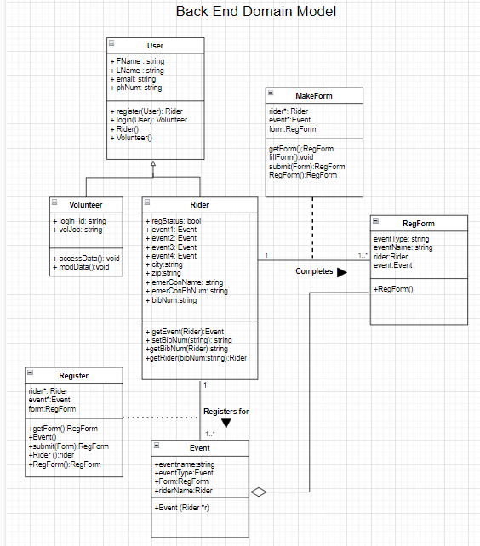
Backend UML

Slide 57


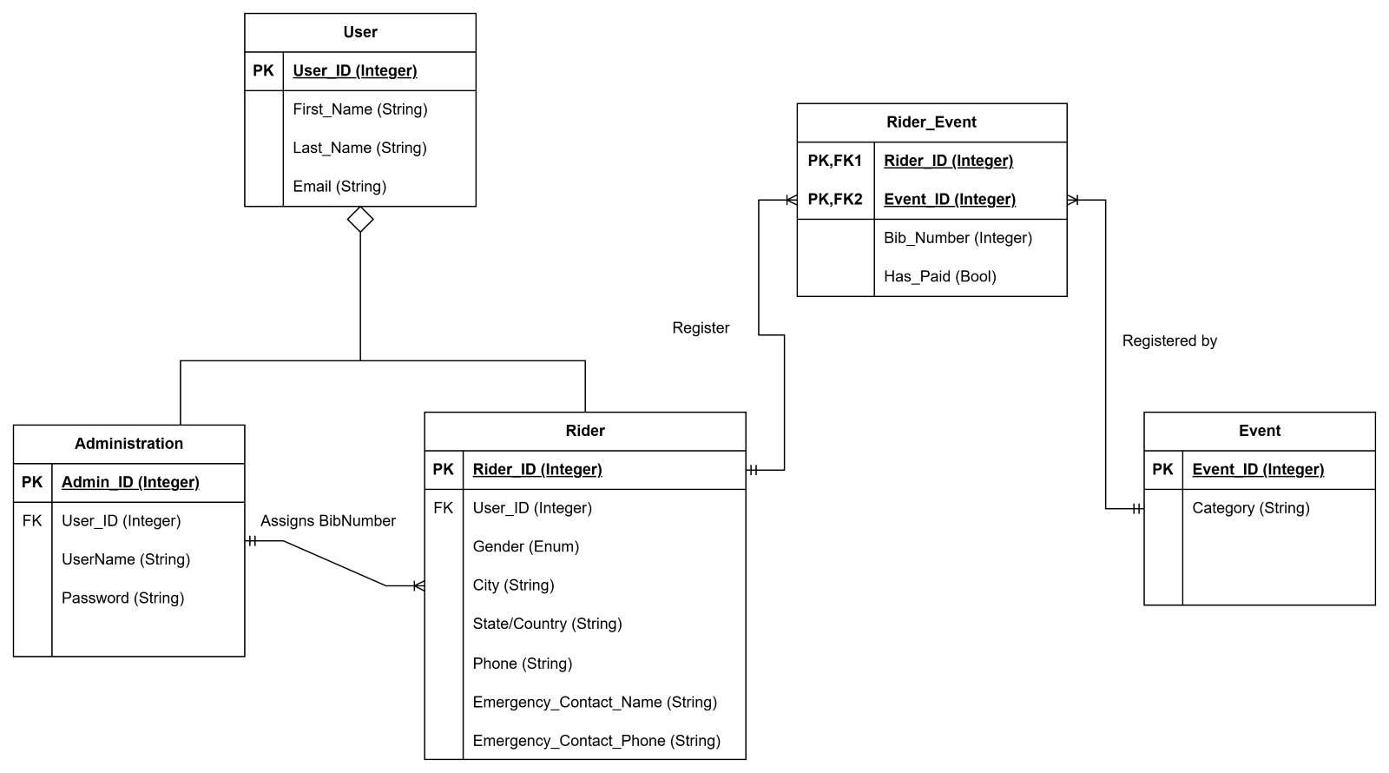
Database domain model

Slide 58
Version control
Link to git repositories
5153 SWE Project repository - initial repository for project
Flutterflowcode repository - sandbox repository created for FlutterFlow

Slide 59
team communication
Email/slack log
Link to slack

Slide 60
Accomplishments
Jon
Tim
Cooper
Demo frontend app pages
SRS
Feasibility study
UML diagrams of frontend pages
IT2 powerpoint presentation
SRS
Feasibility study
LOTS of proof reading
UML diagrams
IT2 powerpoint presentation
Explored React & React Native for app coding
SRS
Feasibility
Database UML
IT2 powerpoint presentation

Slide 61
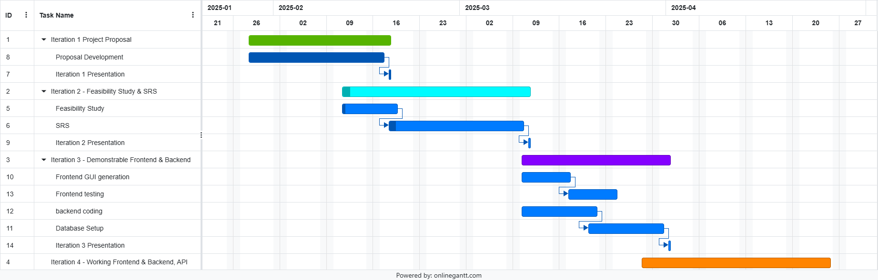
schedule

Slide 62

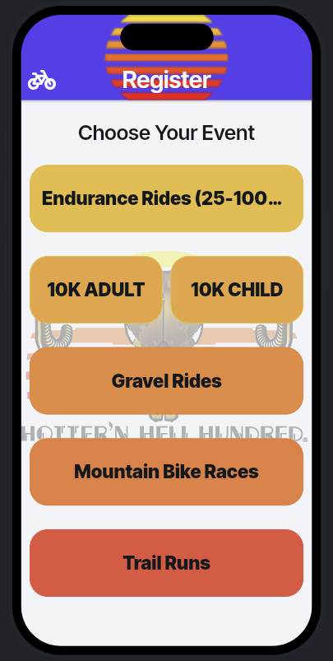
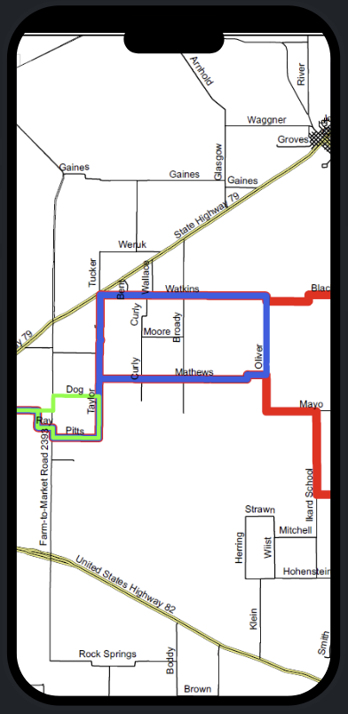
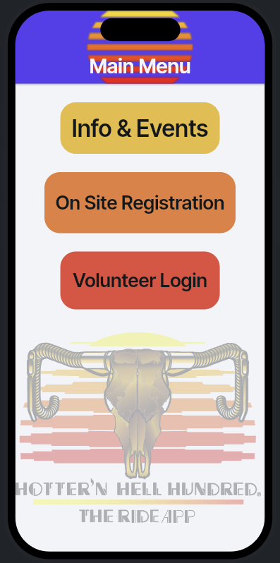
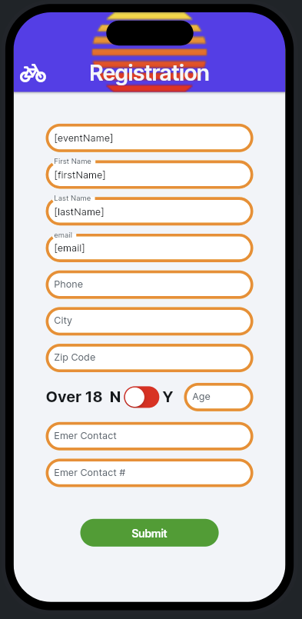
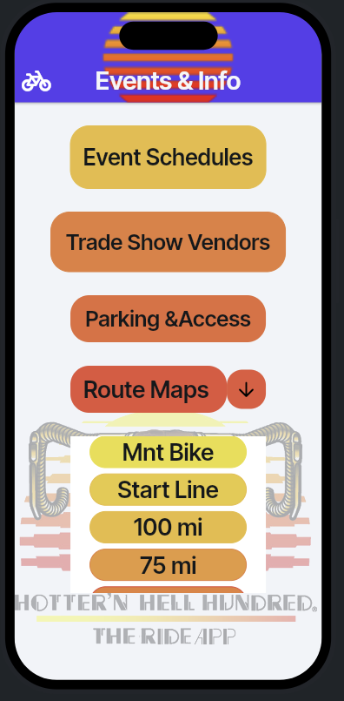
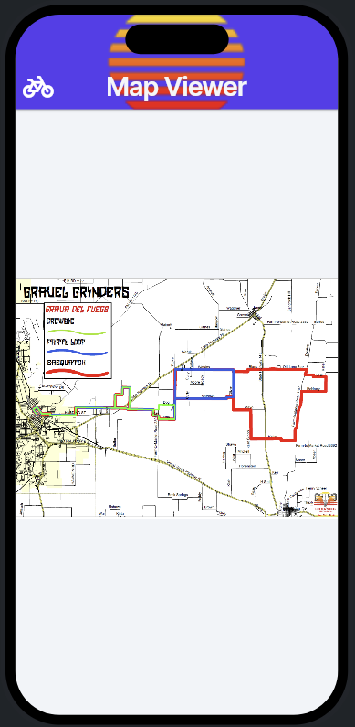
App Demo screenshots

Slide 63
Iteration 3
Tim Haxton
Cooper wolf
Jon scales (Lead)
Frontend integration with database
Implement Database
FastAPI
Surprise last minute things Colmenares assigns
Frontend integration with database
Implement Database
Work on FastAPI
Surprise last minute things Colmenares assigns
Frontend integration with database
Implement Database
FastAPI
Surprise last minute things Colmenares assigns

Slide 64
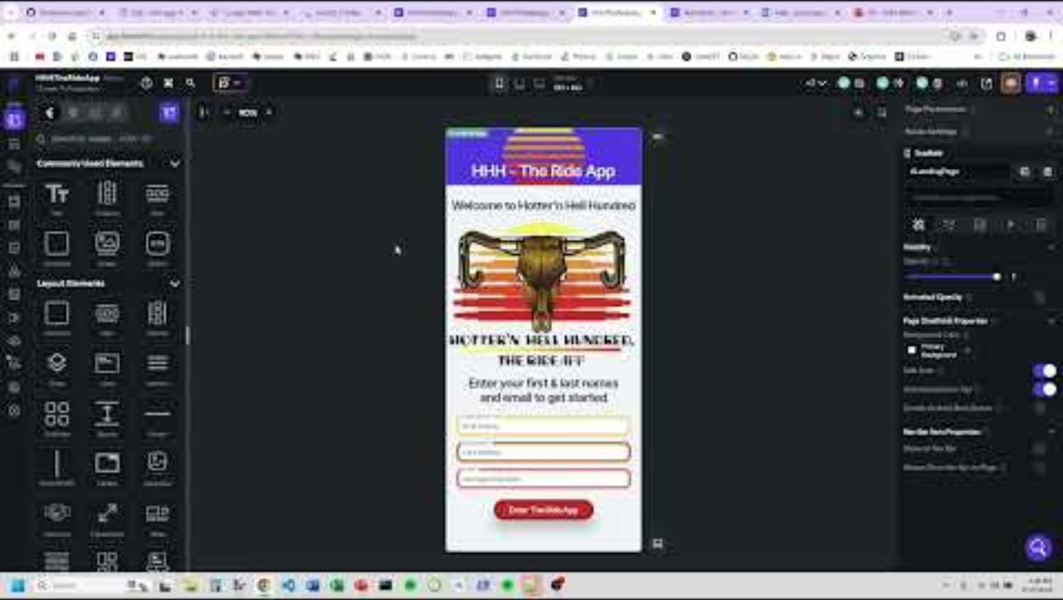
The Ride app demo video

